Slide 1

EzParking
Matteo Ventali 1985026
Valerio Spagnoli 1973484
Serena Ragaglia 1941007
Pierluca Grasso 1950186
Federico De Lullo 1935510

Slide 2

Initial Idea
The objective of this project is to create a distributed parking sharing application that enables users to find and share parking spaces in urban areas with minimal reliance on centralized servers. The system fosters a community-driven approach to solving the challenge of:
finding available parking,
reducing traffic congestion and environmental impact,
promoting collaboration among users.

Slide 3
User Stories & Mockups

Slide 4
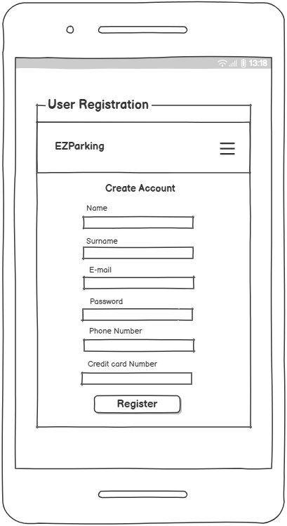
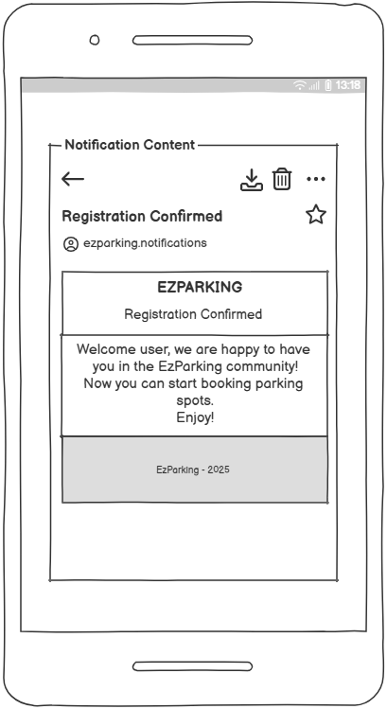
Registration and Login
As a user I want to register to the system so that I can access to the application.
As a user I want to login into the system so that I can authenticate myself to the platform and use app’s functionalities.

Slide 5
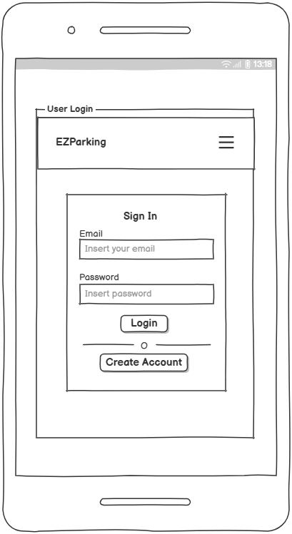
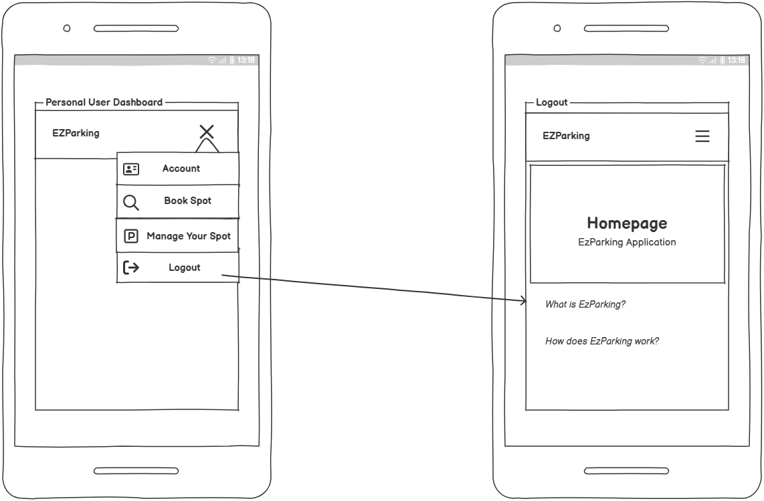
Registration and Login
As a user I want to login into the system so that I can authenticate myself to the platform and use app’s functionalities.
As a user I want to logout from the system so that I can exit from the platform while I don’t use it.

Slide 6
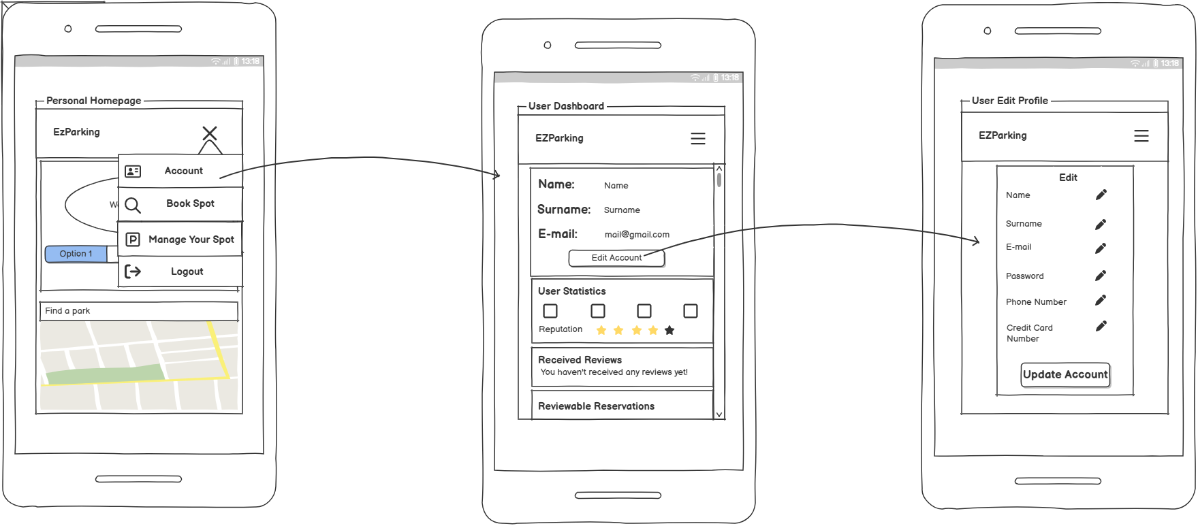
Edit Personal Profile
As a user I want to modify personal data so that I can keep updated my account.

Slide 7
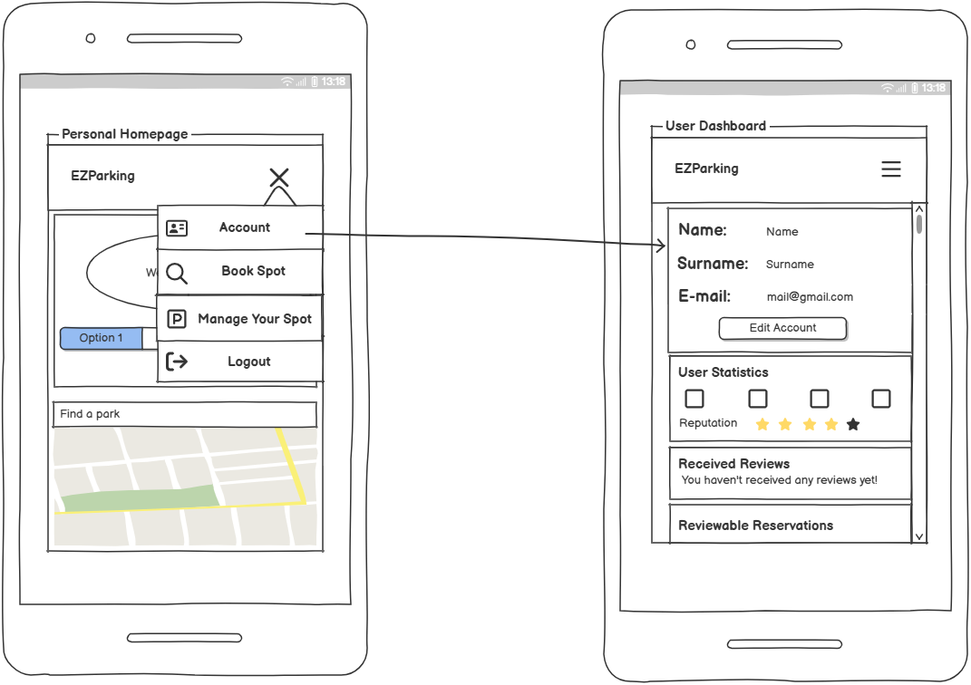
Personal Dashboard
As a user I want to have a personal dashboard so that I can check my personal data and history.
As user I want to see my statistics in the personal dashboard, so I can know the number of my active reservations, my available parking spots and more.
As a driver I want to access my reputation score on my dashboard so I can know which parking spaces I can book.
As a driver I want to see all the reviews I have received from the residents so that I can evaluate my behaviour.

Slide 8
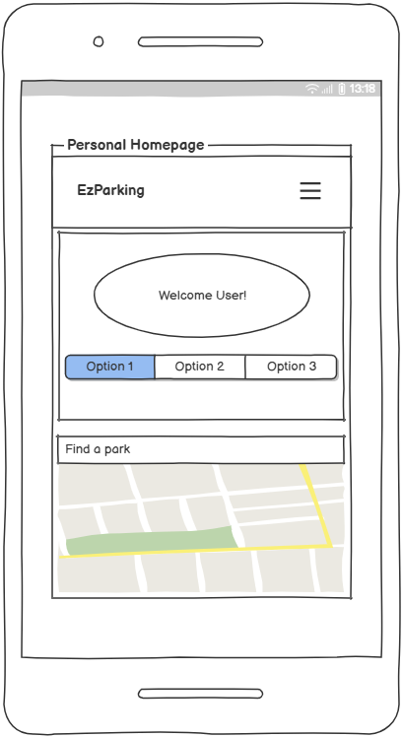
Personal Homepage
As a user I want to see all the functionalities of the app in my homepage so that I can access easily to them.
As a driver I want a map in the homepage that displays all the available parking spots so that I can precisely choose the parking spot position.

Slide 9
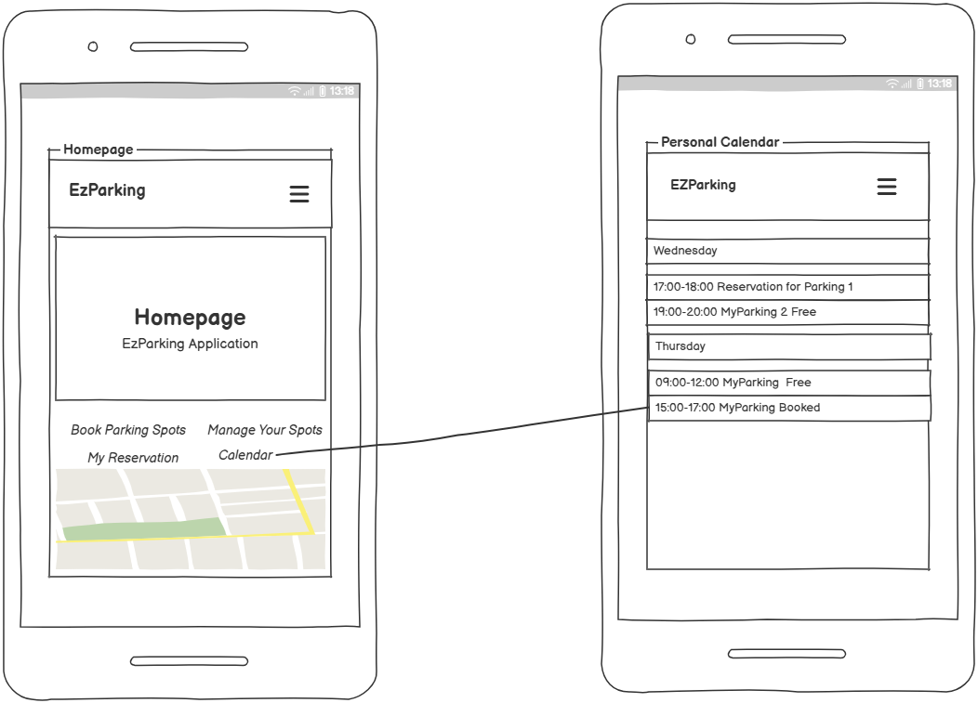
Calendar View
As a user I want to see all my bookings and/or my parking spots in a calendar view, so I can quickly understand my schedule and have a clear overview of my reservations.

Slide 10
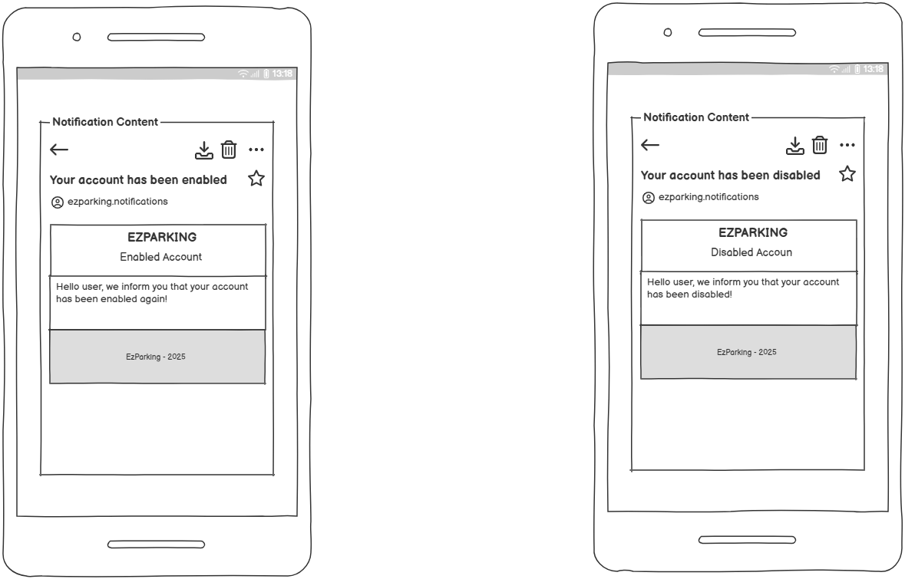
Account Status Notification
As a user I want to receive a notification if my account has been disabled or enabled by administrators so that I know if I can use the app.

Slide 11
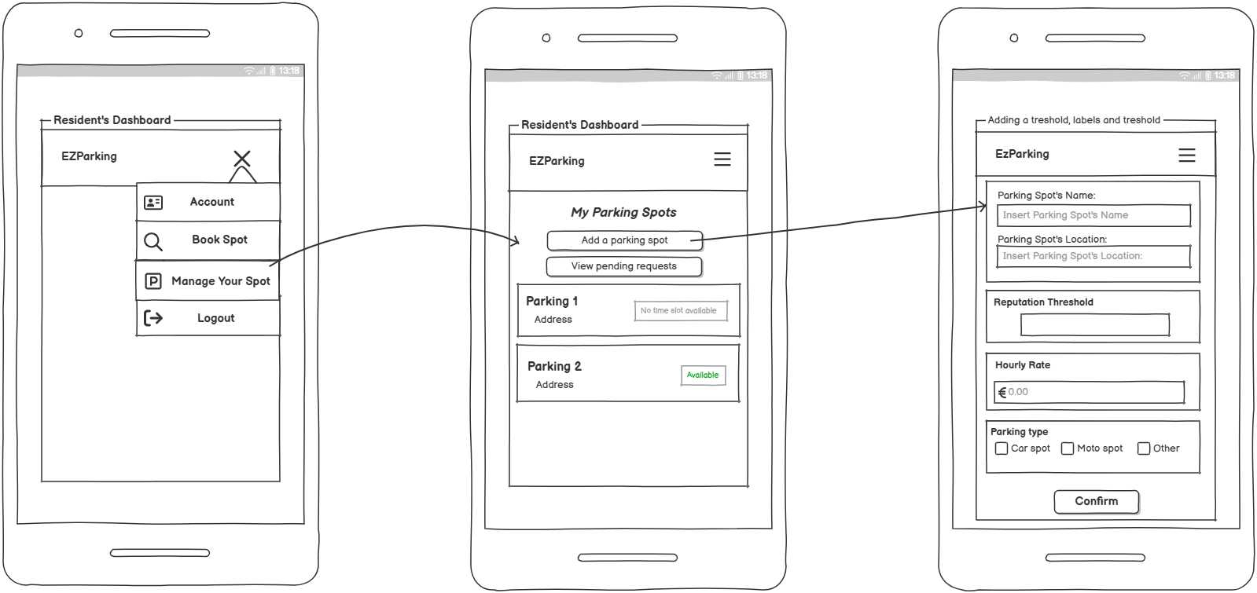
Adding a Parking Spot
As a resident I want to insert into the system my parking space so that I can share it with other users and gain revenues.
As a resident I want to assign labels to my parking spots so that drivers can easily search for them.
As a resident I want to set a reputation treshold to reserve a parking spot, so that I can give priority to higher reputation users.

Slide 12
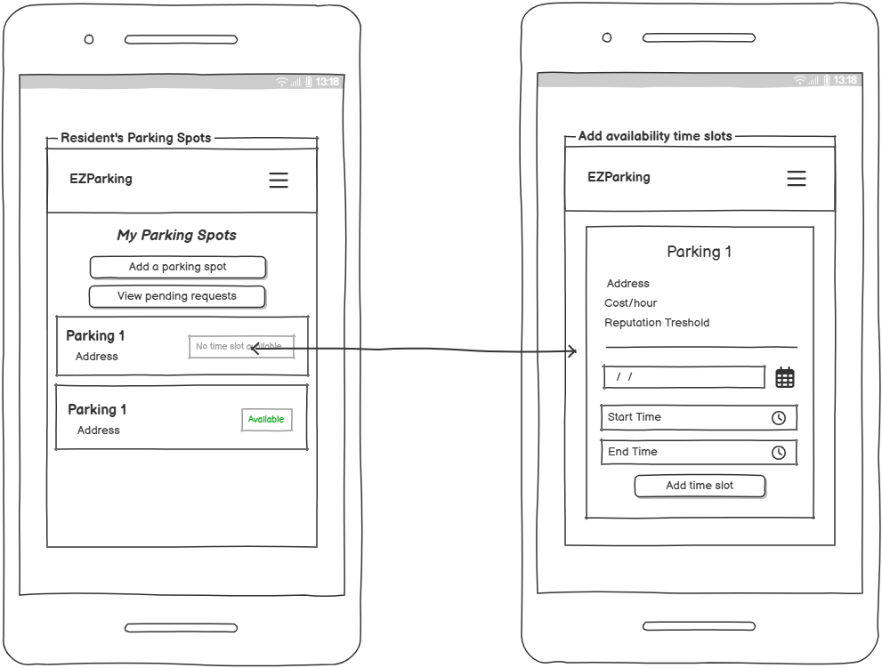
Adding a Time Slot
As a resident I want to view a list of all my parking spots and add availability time slots, so I can decide when each spot can be booked by the drivers.

Slide 13
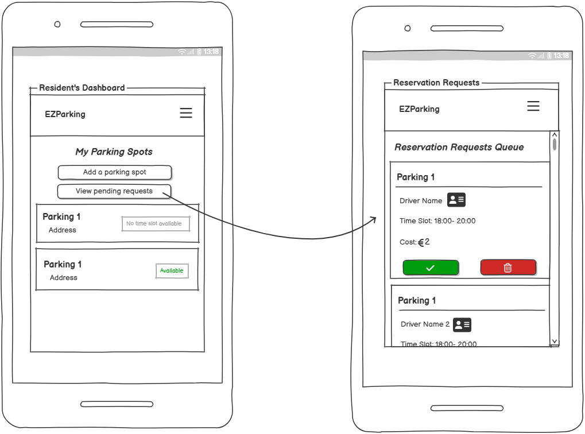
Manage Driver’s Requests
As a resident I want to view all booking requests for my parking spots so that I can choose which drivers to authorize for each specific spot and time slot.
As a resident I want to reject a reservation request so that I can have the full control of my parking spaces.

Slide 14
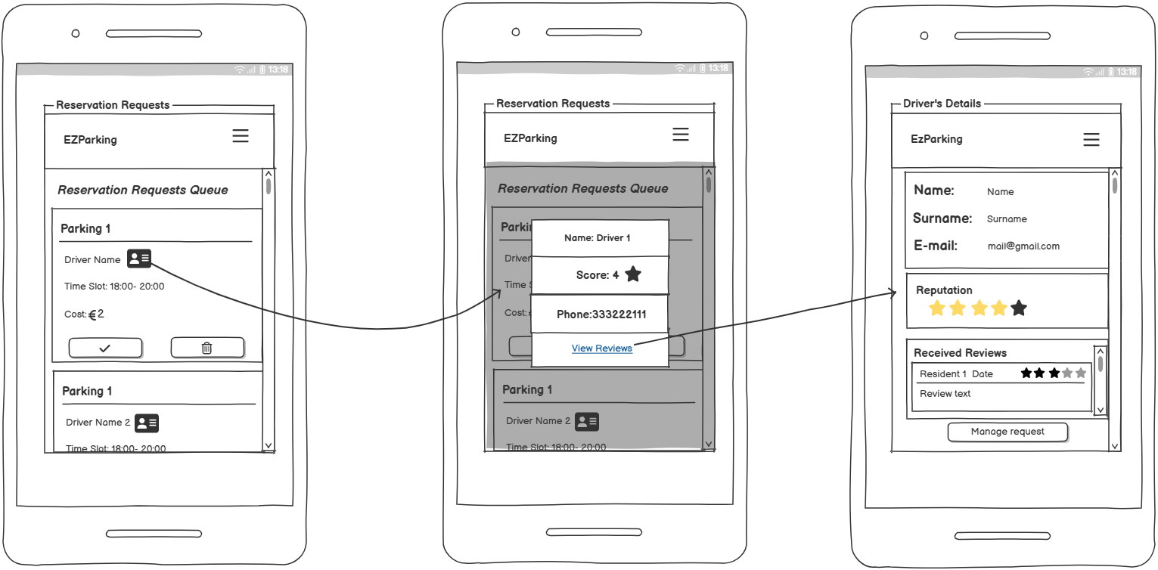
Manage Driver’s Requests
As a resident I want to see driver's details and reviews in a request so that I can choose if accept the request.

Slide 15
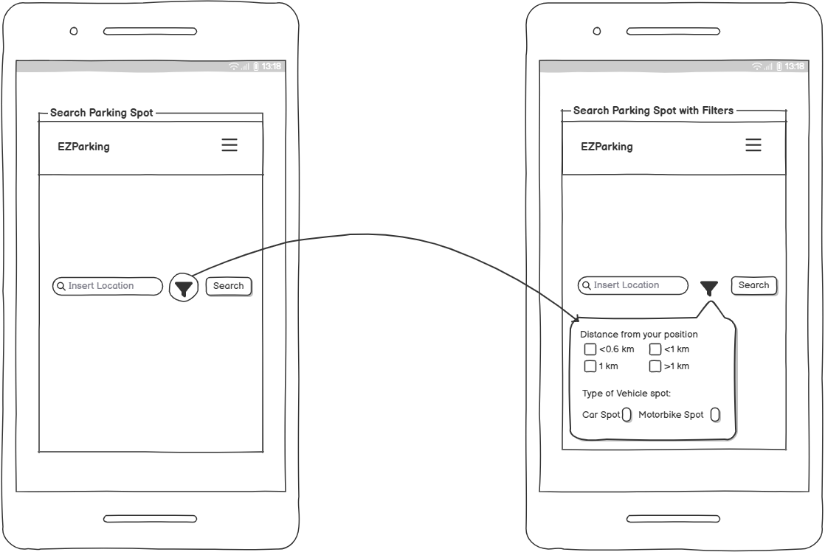
Parking Spot Search
As a driver I want to search for available parking spots so that I can book it.
As a driver I want to be able to search parking spots through filters so that I can find the best parking for my needs.
As a driver I want to search for a parking spot selecting a distance range so that I can find the parking space in the best possible position.

Slide 16
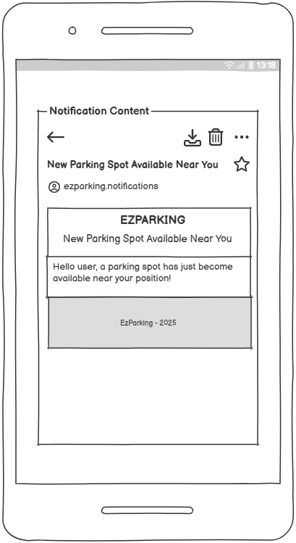
Parking Spot Search
As a driver I want to receive a notifcation when there is a free parking spot near my current position so I can book it if I need it

Slide 17
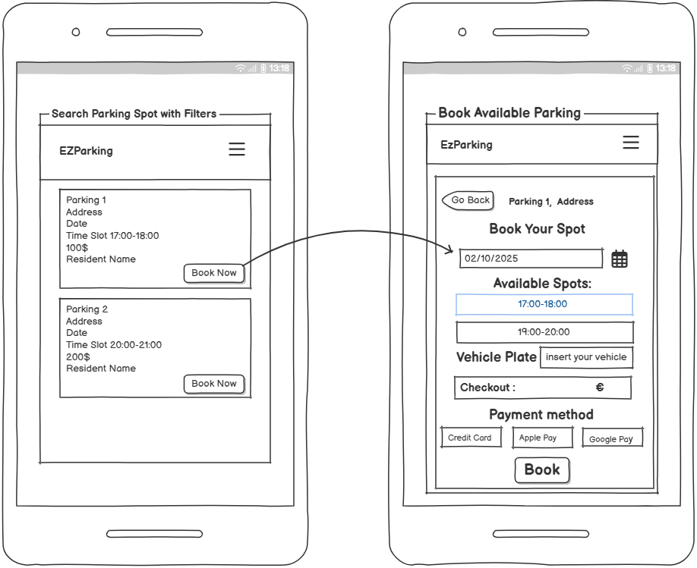
Book a Parking Spot
As a driver I want to book a parking spot for a specific interval of time and pay for it so that I can easily park my car.
As a driver I want to choose the payment method so that I can pay the parking spot in several digital ways.

Slide 18
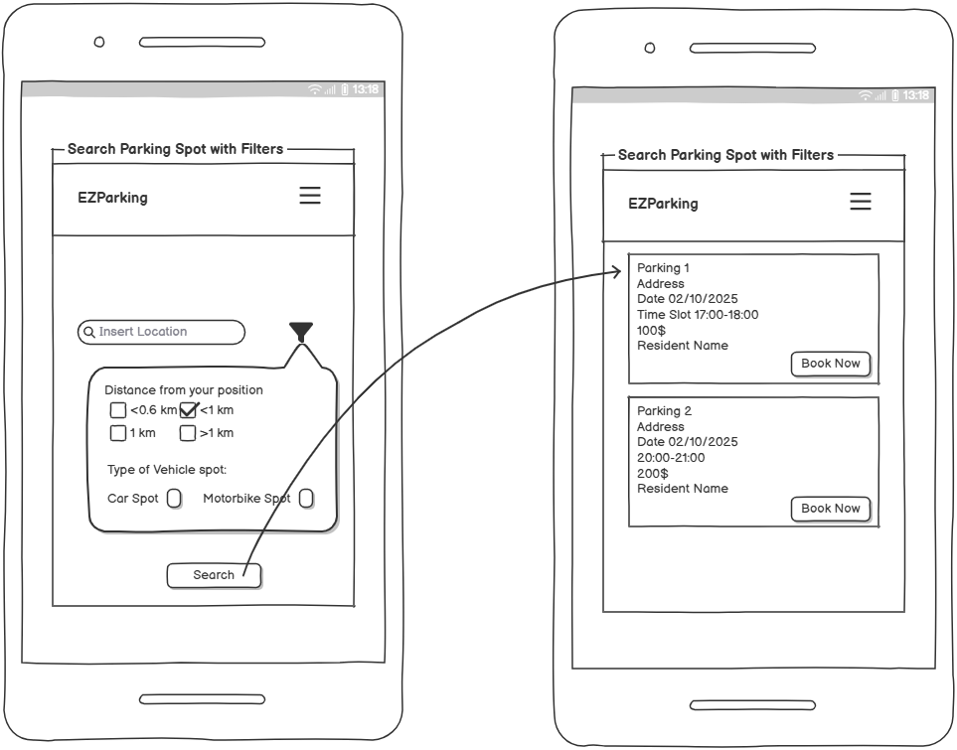
Book a Parking Spot
As a driver I want to see all parking spots available when I search for them, in order to decide myself which I want to book.

Slide 19
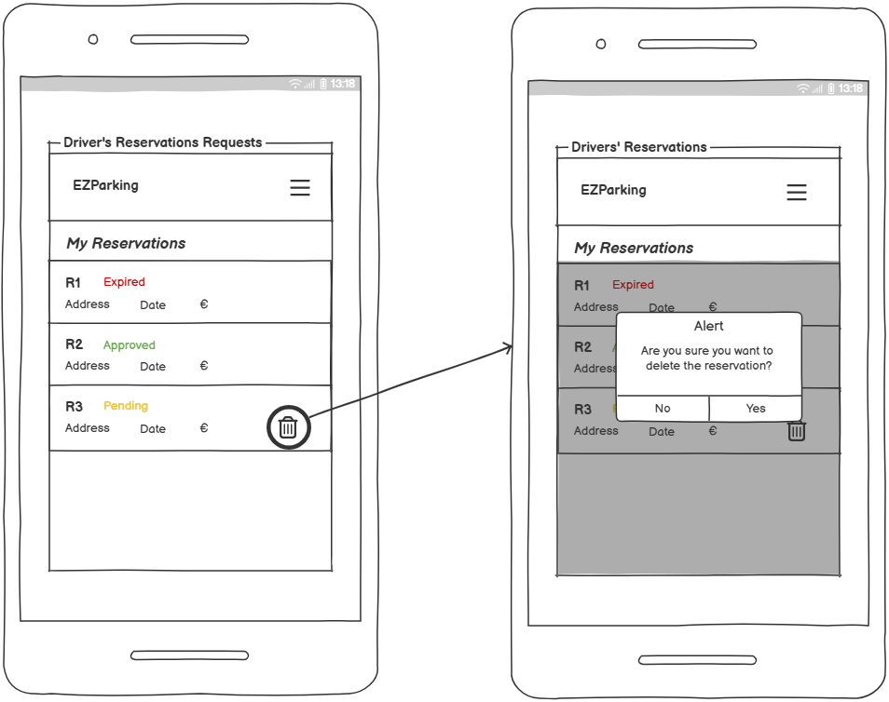
Driver’s Requests
As a driver I want to see the list of all my reservations requests, so that I can see which are still waiting to be accepted by the resident and which have been already accepted or rejected.
As a driver I want to be able to delete a reservation request so that I can free a parking spot if I don’t need it anymore.

Slide 20
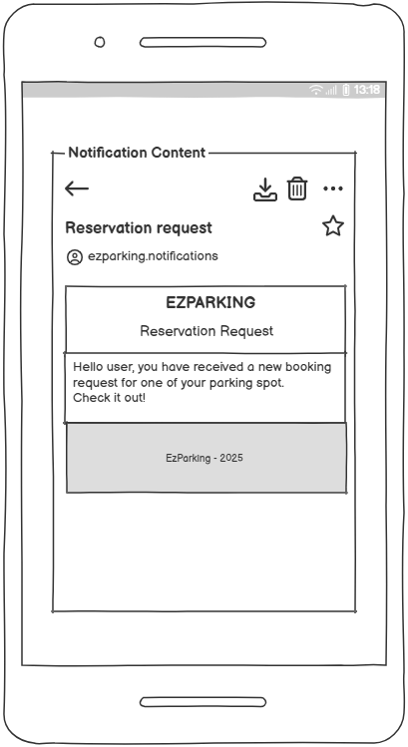
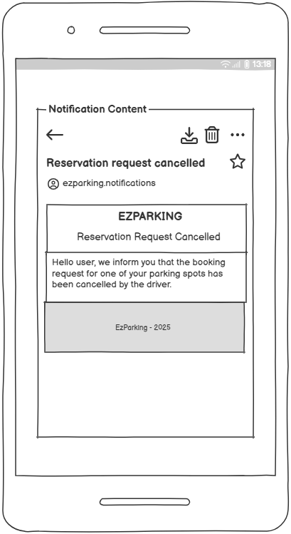
Booking Requests Notifications
As a resident I want to receive notifications when a driver asks for a booking so that I’m informed about it.
As a resident I want to receive a notification if a driver cancels their booking request on my parking spot, so I can be updated in real time about the demand for my parking spots.

Slide 21
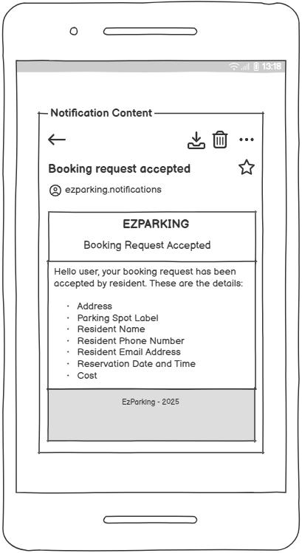
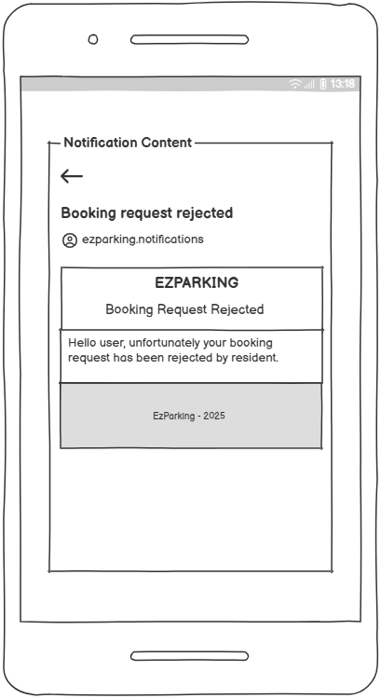
Booking Requests Notifications
As a driver I want to receive the booking confirmation by email when the resident accepts my request, so that I can check the reservation details.
As a driver I want to receive the details of the resident after a booking so that I can contact them if needed.
As a driver I want to receive a notification when a resident rejects my request, so I can know whether I have to book another parking spot.

Slide 22
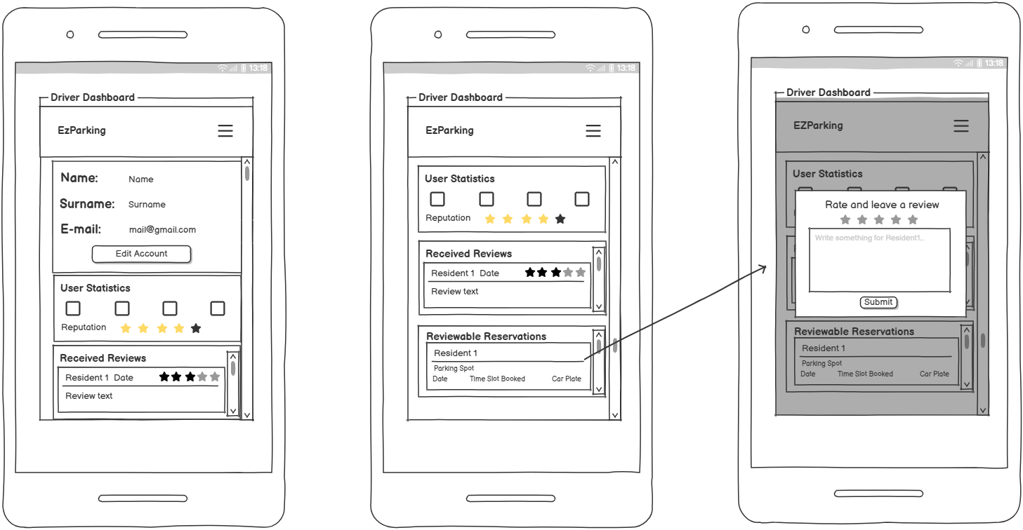
Ratings and Reviews System
As a driver I want to rate and comment the parking service so that I can share my parking experience with other drivers.
As a driver I want to rate the resident whose parking spot I booked, so that I can share my experience.

Slide 23
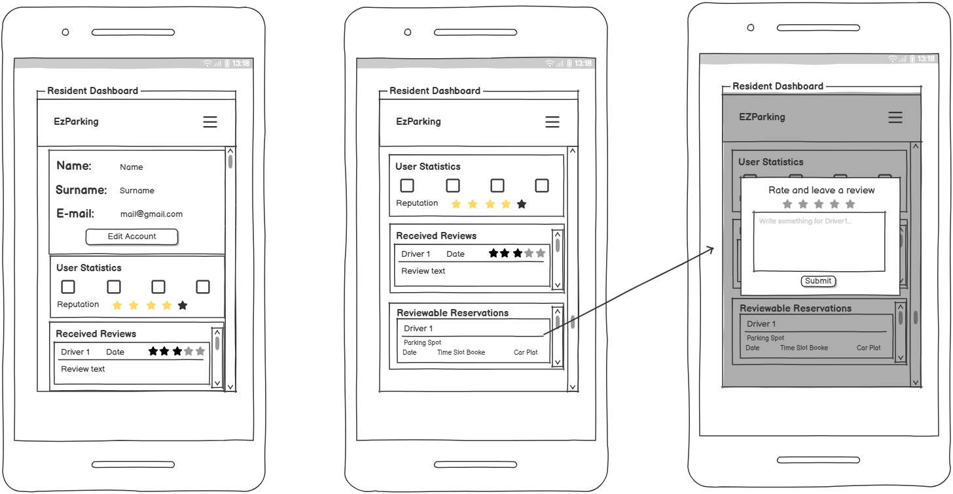
Ratings and Reviews System
As a resident I want to rate a driver that used one of my parking spots, so that I can share the related experience.
As a resident I want to see all the reviews I have received from the drivers so that I can evaluate my behaviour.

Slide 24
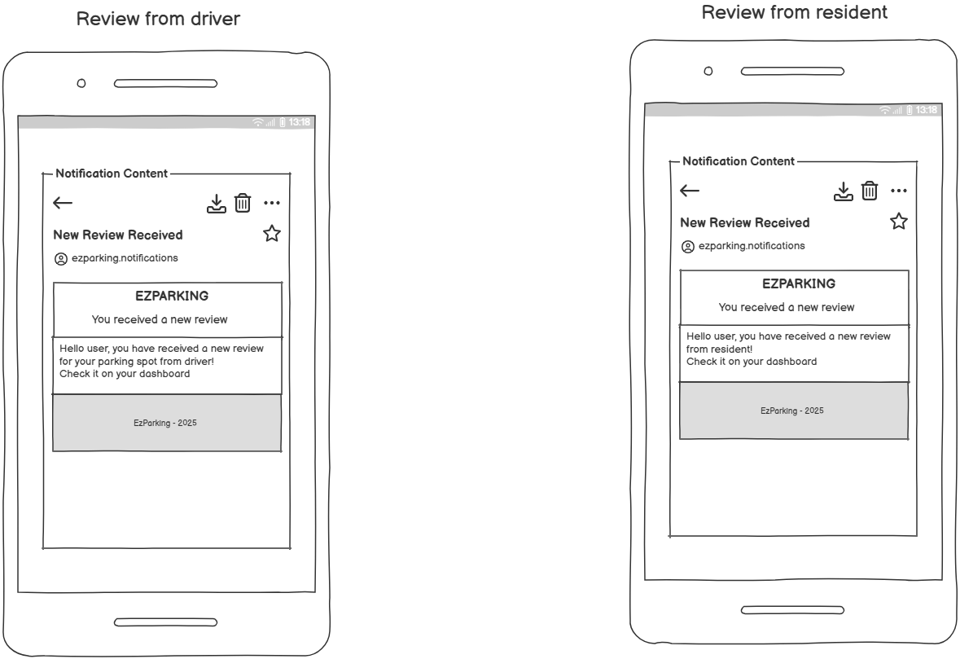
Ratings and Reviews System
As a user I want to receive a notification when other users leave me reviews and ratings so I can check immediately how was their experience.

Slide 25
Software estimation

Slide 26
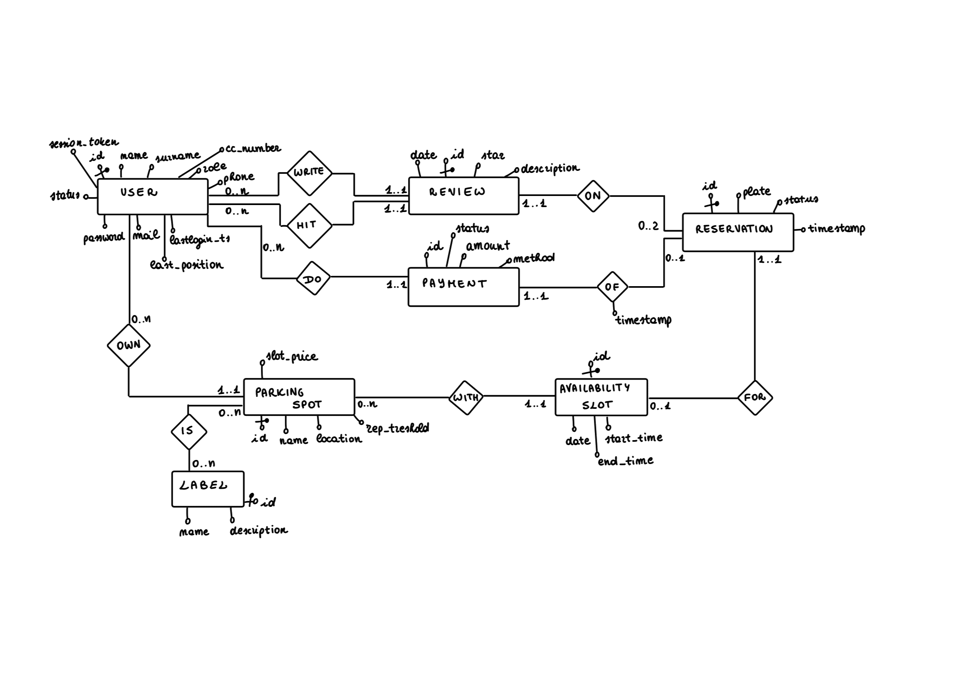
Sketch Diagram

Slide 27
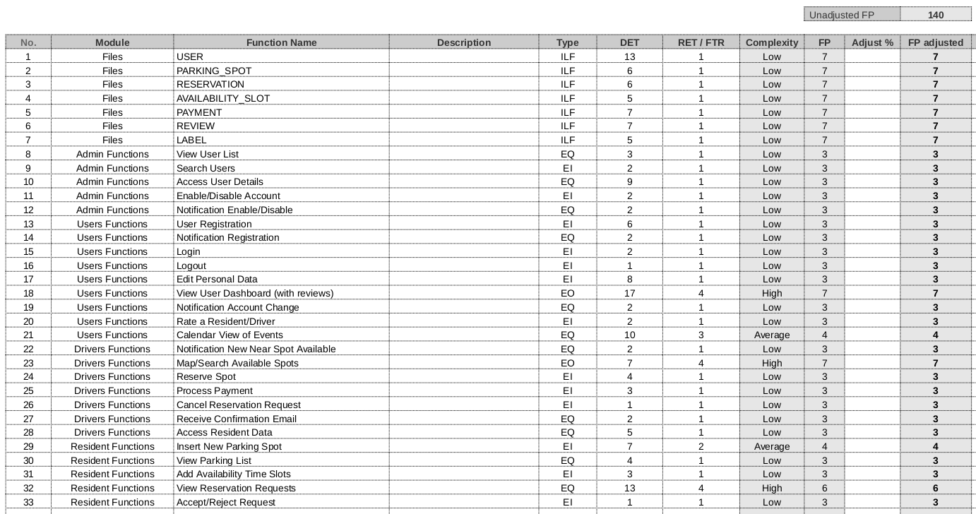
Function Points
7 ILFs
26 Main Functions
140 UFP

Slide 28
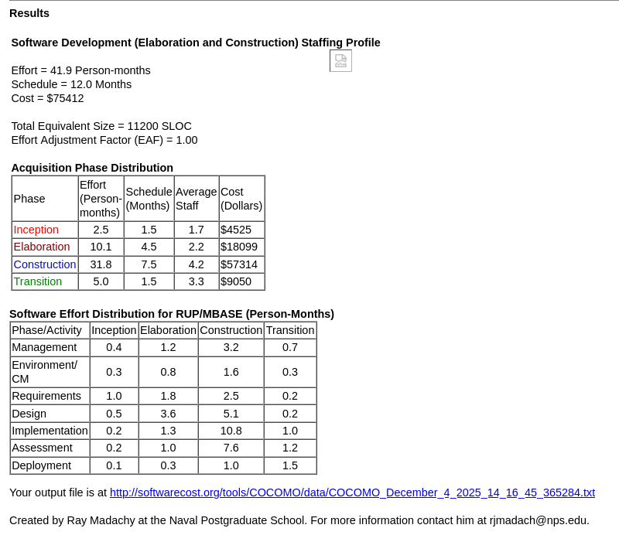
COCOMO II
Early-Model
Scale-Driver set to Nominal
140 UFP = 12 Months of work
Why have we been so fast?
AI help
Unexpected strong cohesion
...

Slide 29
System
Architecture

Slide 30
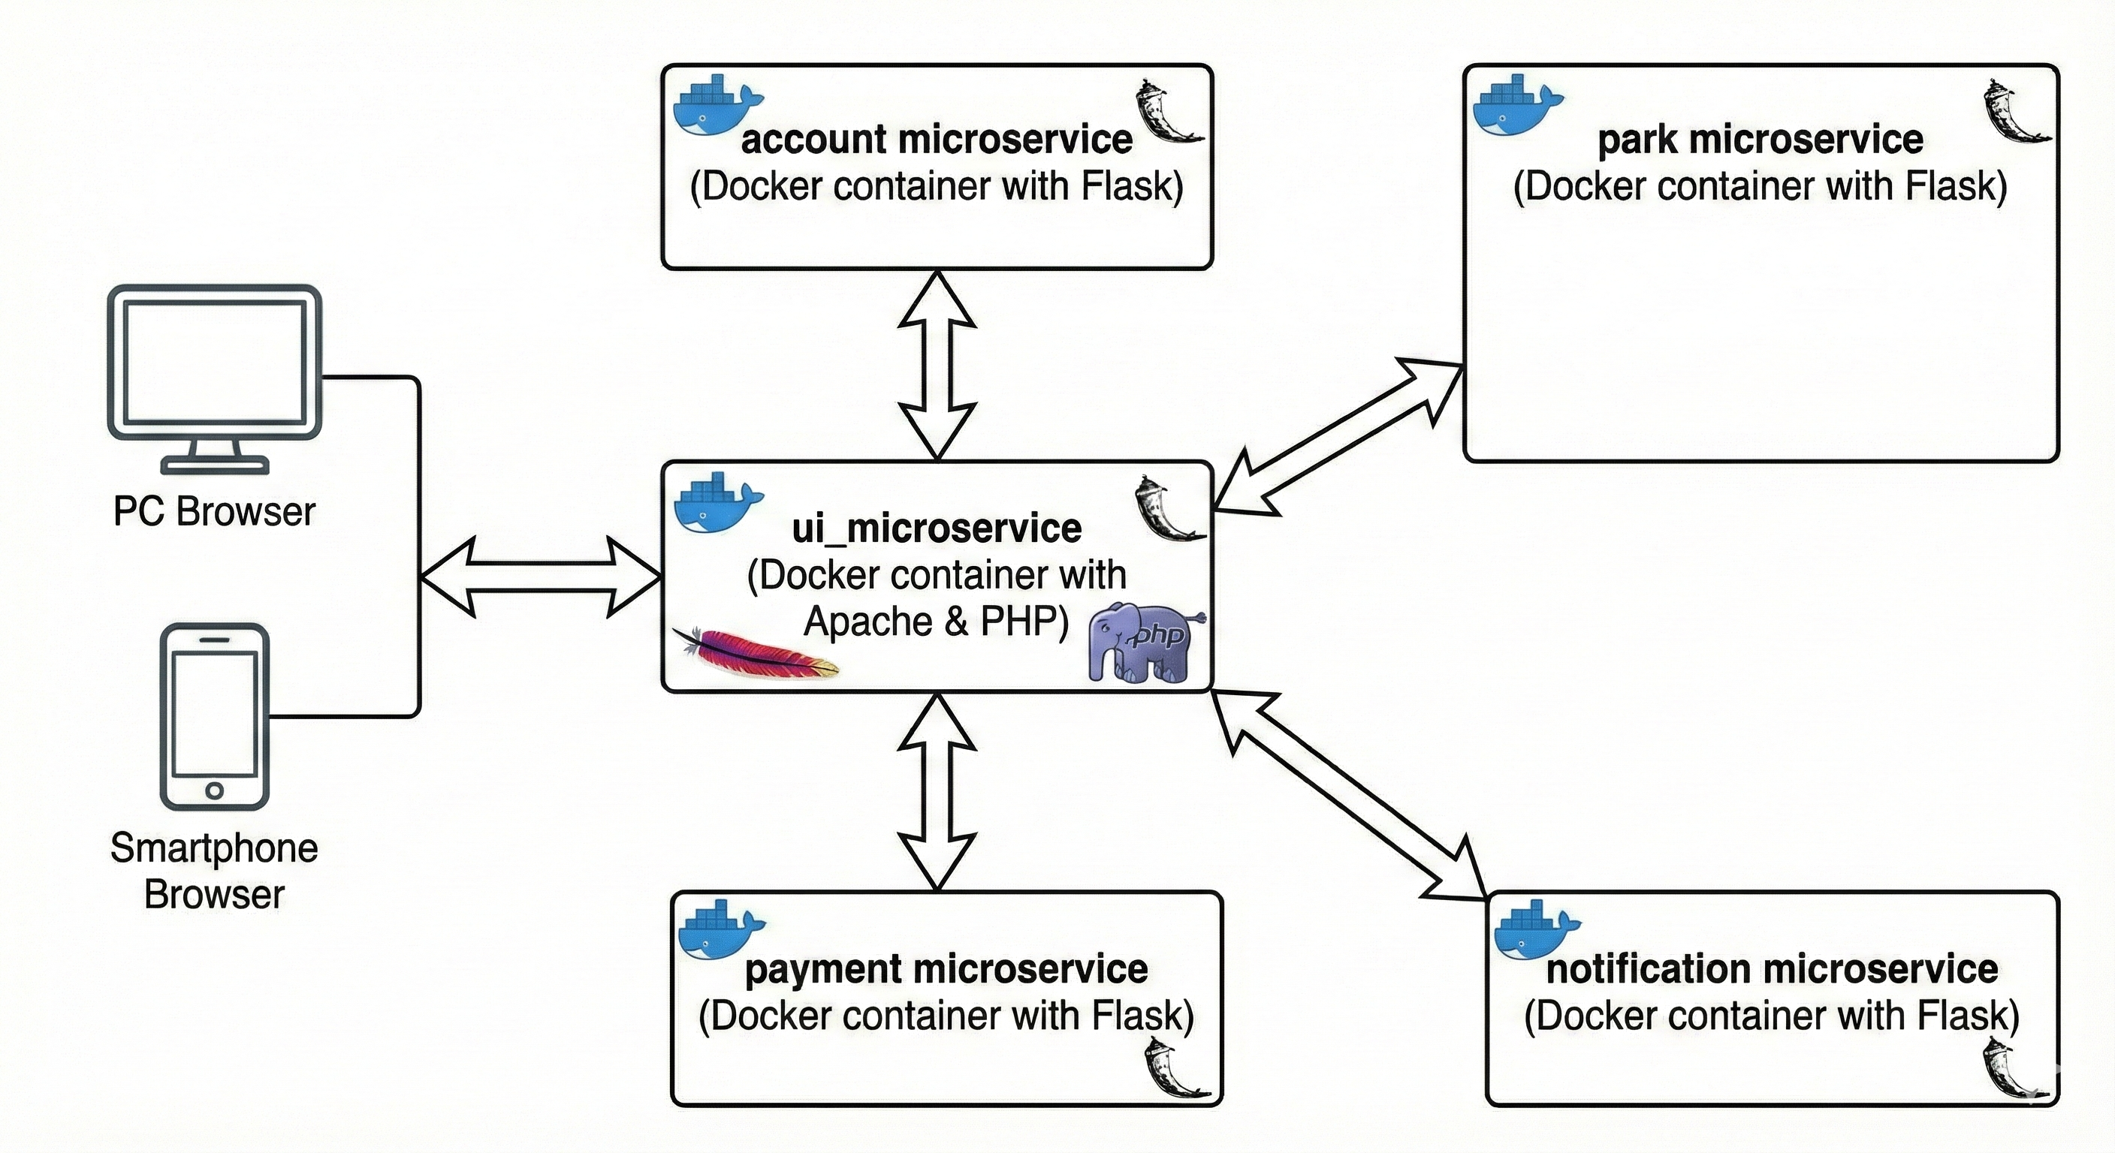
Infrastructure Diagram

Slide 31


Technologies and framework
Architecture & Orchestration:
Microservices-based architecture.
Component orchestration via Docker Compose.
Database & Persistence:
Ensures data persistence for Docker containers.
Stores databases for all microservices components.

Slide 32


Technologies and framework
REST microservices:
implements RESTful interfaces easily.
handles HTTP requests/responses for microservices.
Database access:
facilitates database access for Python microservices.
maps Python objects to database tables efficiently.

Slide 33


External Services
Maps and Geolocalization:
Localization of users and parking spots based on GPS coordinates.
Conversion coordinates-address.
Mail service:
Send notification to users for various events.

Slide 34
Sprints

Slide 35


Sprints Organization
The project was developed in the span of eight sprints, from October to December 2025.
Each sprint had an objective: the implementation of one of the microservices with the respective interface.
Each task was assigned to at least one team member, and we tracked the time spent to complete it, with the SCRUM Spreadsheet.
The five sprints took place in the span of at most two weeks.

Slide 36
Sprints Organization
1
5
Documentation Managment
Booking and Payment Systems
2
6
Account Managment
Notification System
3
7
Resident Functionalities
Reputation and Rating System
4
8
Parking Search
Admin Functionalities

Slide 37
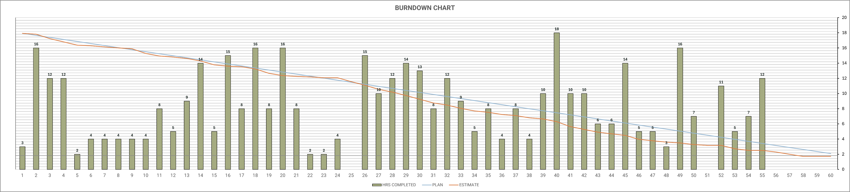
Burndown Chart
From October 1st to December 12th
Estimated Hours: 452
Completed Hours: 450

Slide 38
Demo

